Slide 1


Introduction about Ann-Car Price Prediction
The process of predicting Ann-Car prices involves the use of advanced algorithms and data analysis to forecast the value of a vehicle based on various factors. As the automotive industry continues to evolve, accurate price prediction becomes increasingly important for both buyers and sellers. This involves analyzing historical pricing data, current market trends, and the specific features of individual cars. By leveraging machine learning and statistical modeling, accurate price predictions can be made, providing valuable insights for both consumers and dealers.

Slide 2

Agenda
1
Introduction
Provide an overview of the goals and objectives of the Ann-Car price prediction project.
2
Problem Statement
Identify the key challenges and issues in the automotive market that the price prediction model aims to address.
3
Project Overview
Discuss the approach, methodologies, and technologies used in the development of the price prediction model.

Slide 3
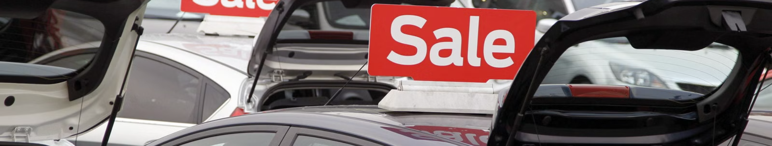
Problem Statement
1
Misaligned Pricing
2
Market Volatility
3
Lack of Transparency
Many car buyers and sellers struggle with accurately pricing their vehicles, leading to inefficiencies and potential financial loss.
The automotive market is subject to rapid changes and fluctuations, making it challenging to predict accurate prices.
There's a lack of transparency in pricing, leading to distrust and uncertainty among both buyers and sellers.

Slide 4
Project Overview
Data Collection
Model Development
Testing and Refinement
Gathering comprehensive data on vehicle specifications, market trends, and historical pricing information.
Utilizing advanced machine learning algorithms to develop a predictive model for Ann-Car pricing.
Evaluating the model's accuracy and making refinements to ensure optimal performance and reliability.

Slide 5



Who Are the End Users
Car Dealers
Car Buyers
Data Analysts
Utilize accurate price predictions to make informed decisions and optimize their inventory pricing.
Gain transparency and confidence in the pricing of vehicles, ensuring fair and reasonable transactions.
Leverage predictive insights to understand market trends and dynamics within the automotive industry.

Slide 6

My Solution and Its Value Proposition
Precise Pricing
Increased Transparency
Generate highly accurate price predictions based on extensive data analysis and machine learning algorithms.
Create a more transparent and trustworthy automotive market by providing fair and data-driven pricing insights.
Market Adaptability
Enable businesses and consumers to adapt to market changes and make informed pricing decisions.

Slide 7




The Wow in My Solution
Real-time Updates
Continuous monitoring and updating of pricing predictions to reflect current market conditions.
Interactive Visualization
Engage users with interactive data visualizations to comprehend the factors influencing pricing predictions.
Predictive Insights
Offer valuable insights and recommendations to optimize pricing strategies and maximize value.

Slide 8
Modeling
Regression Analysis
Utilizing regression algorithms to analyze the correlation between various car attributes and their impact on pricing.
Ensemble Methods
Implementing ensemble learning techniques to enhance prediction accuracy and mitigate overfitting.
Feature Engineering
Engineering relevant features to capture the nuanced aspects affecting Ann-Car pricing.

Slide 9
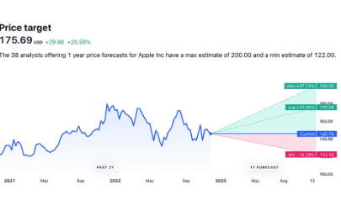


Results
Accurate Predictions
Positive Feedback
Business Impact
Displaying a visual representation of the model's accuracy in predicting Ann-Car prices.
Illustrating satisfied customers and successful transactions based on the price predictions.
Showcasing the positive impact of accurate pricing on the profitability of car dealerships and sellers.

